Slide 1
Employee Data Analysis using Excel
STUDENT NAME : S.Sunmitha
REGISTER NO : 312209513
DEPARTMENT : BBM
COLLEGE : Anna Adarsh College for Women

Slide 2
PROJECT TITLE
Employee Performance Analysis using Excel

Slide 3


AGENDA
Problem Statement
Project Overview
End Users
Our Solution and Proposition
Dataset Description
Modelling Approach
Results and Discussion
Conclusion
3/21/2024 Annual Review

Slide 4

PROBLEM STATEMENT
Inconsistent evaluation methods lead to biased performance assessment.
Lack of clear goals and expectation hinders accurate performance measurement.
Insufficient data and analytics make it difficult to identify areas for improvement.
Ineffective feedback mechanisms fail to drive employee growth and development.
Absence of standardized performance metrics limits comparability and benchmarking.

Slide 5

PROJECT OVERVIEW
This project aims to develop a comprehensive framework for evaluating employee performance . The scope includes analyzing job responsibilities, goals and key performance indicators. A combination of quantitative and qualitative approaches will be used to assess performance. The expected outcome is accurate performance assessments and targeted development plans .This will enable data-driven decision- making to enhance organizational efficiency.

Slide 6
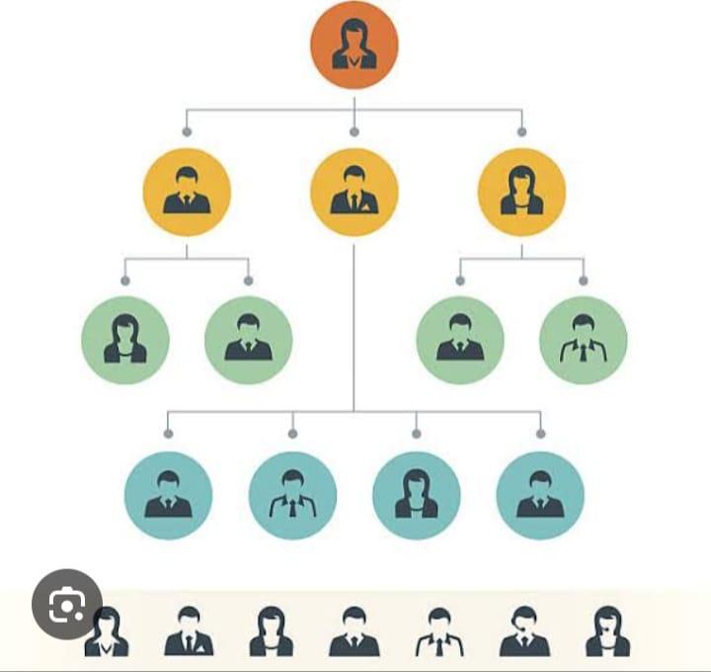

WHO ARE THE END USERS?

Slide 7

OUR SOLUTION AND ITS VALUE PROPOSITION
Conditional formatting-missing
Filter-remove
Formula-performance
Pivot-summary
Graph-data visualization

Slide 8
Dataset Description
Employee dataset form Kaggle
26-features
We selected 9-features
-Employee ID number
-Employee Name
-Employee Type
-Performance Level
-Gender
-Employee Rating Number

Slide 9

THE "WOW" IN OUR SOLUTION
Using this formula we have measured the performance level of employee working in an organization
Performance Level = IFS(Z8>=5,”VERY HIGH”,Z8>=4,”HIGH”,Z3>=3,”MED”,”TRUE”,”LOW”)
3/21/2024 Annual Review
9

Slide 10
MODELLING
Data collection
-Download the employee dataset from Kaggle
-After the download an Excel sheet will open
-In that sheet we have employee data details which has 26-features.
Features collection
-We are selecting 9-features for our project
-In that features we have, employee id, employee name, employee type, gender, performance level, employee rating.
10

Slide 11
MODELLING
Data cleaning
-In this method, we clear the empty rows or columns in the sheet.
-By selecting the empty rows and clear using conditional formatting tool.
Performance level
-Here, we calculate the performance of the employees.
-By using a formula we can calculate the performance.
-Using IF formula : IF(Z8>=5,”VERY HIGH”,Z8>=4,”HIGH”,Z8>=3,”MED”,”TRUE”,”LOW”)

Slide 12
MODELLING
Pivot table
-After creating the performance level, click on pivot table icon.
-In that an application will appear as row, column,
fields.
-Select the required items and click OK.
-Then using the details create a graph
Summary
-Using this method, we can know the performance level of the employees through graph.

Slide 13
MODELLING
Visualization

Slide 14
RESULTS
14

Slide 15
conclusion
Effective employee performance analysis is crucial for driving organizational success. By implementing a standardized evaluation framework, leveraging data analytics and forecasting a culture of constructive feedback. Accurate performance assessments enable informed decision-making, targeted development initiatives and improved employee engagement .A well-designed performance analysis system is important for achieving strategic objectives, enhancing productivity and sustaining competitive advantage.

